Slide 1
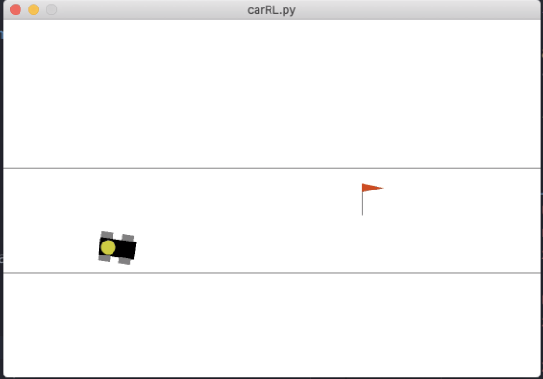
Reinforcement Learning
for Car Control
#TensorFlow #Machine_Learning
#Python #Simulation
#Self_Driving
MINYOUNG CHANG

Slide 2
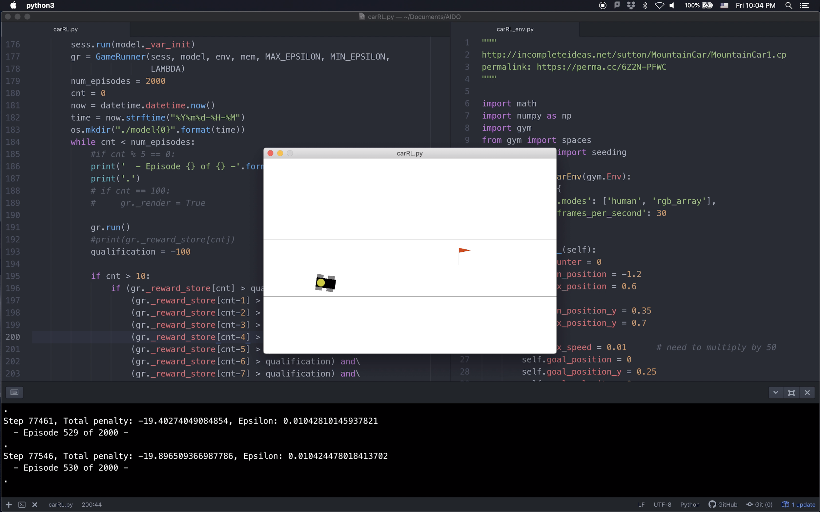
BASIC SETUP
GOAL POINT
CAR
ROAD
BOUNDARY
PENALTY & EPISODE NUMBER

Slide 3
OBJECTIVE
The goal is to have the car LEARN how to drive toward the FLAG while staying as close as possible to the MID-LANE
In the beginning of each Episode, car is RANDOMLY generated within this box

Slide 4
ACTIONS
Based on the current state of the car, the MODEL chooses one of nine ACTIONS

Slide 5
TYPE OF ACTIONS
ANGULAR VELOCITY
 | STEER LEFT (+ 6 deg/s) | HOLD | STEER RIGHT (- 6 deg/s)
ACCELERATE (+ 0.1 m/s) | #1 | #2 | #3
NO CHANGE | #4 | #5 | #6
DECELERATE (- 0.1 m/s) | #7 | #8 | #9
LINEAR
VELOCITY

Slide 6
PENALTY
The PENALTY of each action is calculated based on the vertical distance between the red line and the car
PLUS, there is a DEFAULT PENALTY for every action, to encourage the car to reach the flag with the least number of actions

Slide 7
MODEL
CURRENT STATE
MODEL
OUTPUT
NEXT STATE
x_car
y_car
velocity
omega
x_flag
y_flag
NEURAL
NETWORK
Penalty
for each Action
x_car
y_car
velocity
omega
x_flag
y_flag
execute the BEST ACTION
UPDATE

Slide 8
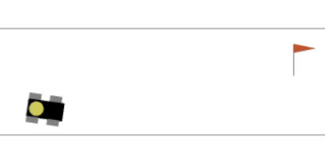
MODEL
INPUT:
(x,y,v,om, x_f,y_f)
 | STEER LEFT (+ 6 deg/s) | HOLD | STEER RIGHT (- 6 deg/s)
ACCELERATE (+ 0.1 m/s) | #1 | #2 | #3
NO CHANGE | #4 | #5 | #6
DECELERATE (- 0.1 m/s) | #7 | #8 | #9

Slide 9
MODEL
Calculates the EXPECTED PENALTY for each action
INPUT:
(x,y,v,om, x_f,y_f)
 | STEER LEFT (+ 6 deg/s) | HOLD | STEER RIGHT (- 6 deg/s)
ACCELERATE (+ 0.1 m/s) | #1 (-34) | #2 (-53) | #3 (-88)
NO CHANGE | #4 (-44) | #5 (-52) | #6 (-90)
DECELERATE (- 0.1 m/s) | #7 (-59) | #8 (-85) | #9 (-98)

Slide 10
MODEL
The BEST ACTION chosen by the current model
Calculates the EXPECTED PENALTY for each action
INPUT:
(x,y,v,om, x_f,y_f)
 | STEER LEFT (+ 6 deg/s) | HOLD | STEER RIGHT (- 6 deg/s)
ACCELERATE (+ 0.1 m/s) | #1 (-34) | #2 (-53) | #3 (-88)
NO CHANGE | #4 (-44) | #5 (-52) | #6 (-90)
DECELERATE (- 0.1 m/s) | #7 (-59) | #8 (-85) | #9 (-98)

Slide 11

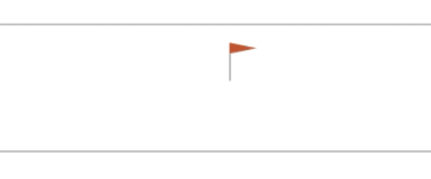
REINFORCEMENT LEARNING
TRAIN MODEL
RUN
MODEL
AGENT
EXPECTED PENALTY
STATE &
ACTUAL
PENALTY
ENVIRONMENT
ACTION
In Reinforcement Learning, the MODEL learns
through TRIAL AND ERROR using feedback form in every ACTION

Slide 12
EPISODE
Each EPISODE ends when the car reaches the flag
TOTAL PENALTY is the sum of the penalty for every action made in the episode

Slide 13
How is the Model
being trained?
#q-learning #memory #randomness
#REINFORCEMENT LEARNING

Slide 14
Q-Learning
Q-TABLE
x_car, y_car, velocity, omega, x_flag, y_flag
 | Action #1 | Action #2 | ... | Action #9
State 1 (-3, 2, 0, 0, 4, 0) | #1 (-34) | #2 (-53) | ... | #9 (-98)
State 2 (-1, 1, 1, .1, 4, 0) | #1 (-54) | #2 (-27) | ... | #9 (-55)
... | ... | ... | ... | ...
State XXX (-.5, .3, 0, .3, 4, 0) | #1 (-34) | #2 (-53) | ... | #9 (-32)

Slide 15
Problem?
It’s the best if I can keep the ENTIRE Q-Table, but there are...
Too many number of possible states
More than three thousand!
Q-Learning
x_car, y_car, velocity, omega, x_flag, y_flag

Slide 16
Solution:
Q-Learning
Only use the MOST RECENT 500 data sets for training the model
 | Action #1 | Action #2 | ... | Action #9
State 1 (-3, 2, 0, 0, 4, 0) | #1 (-34) | #2 (-53) | ... | #9 (-98)
State 2 (-1, 1, 1, .1, 4, 0) | #1 (-54) | #2 (-27) | ... | #9 (-55)
... | ... | ... | ... | ...
State 500 (-.5, .3, 0, .3, 4, 0) | #1 (-34) | #2 (-53) | ... | #9 (-32)
The dataset will be filled with more refined data as the process goes

Slide 17
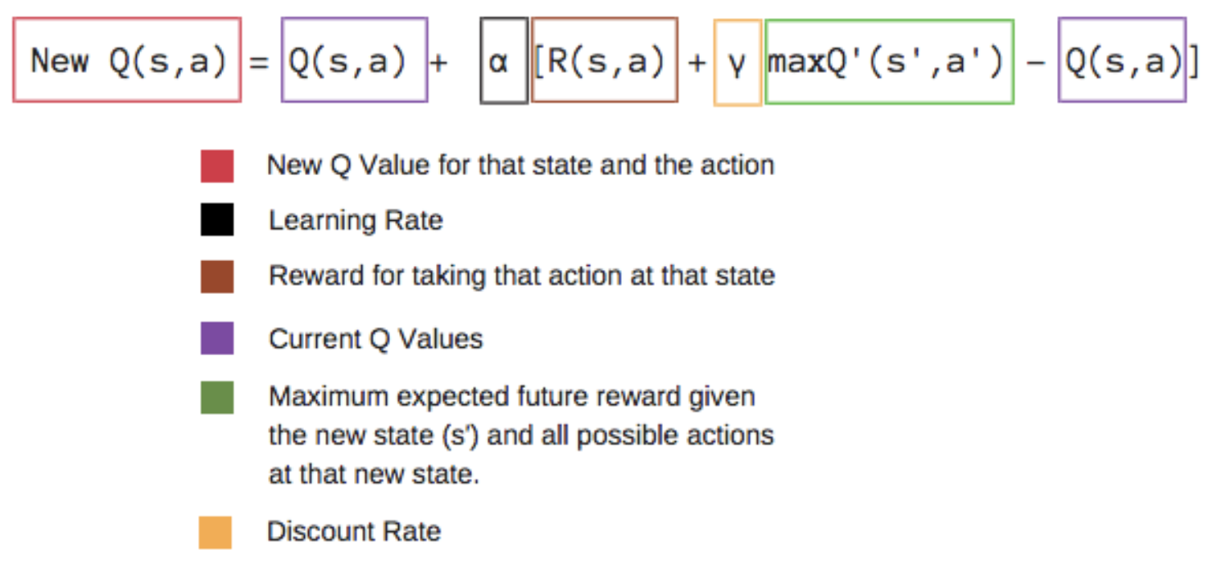
https://medium.freecodecamp.org/an-introduction-to-q-learning-reinforcement-learning-14ac0b4493cc
Q-Learning

Slide 18
Procedure
1 ~ 500 states
1st Model
2 ~ 501 states
2nd Model
1st
2nd
3rd
….
500th
NEURAL
NETWORK
2nd
3rd
4th
….
501st
NEURAL
NETWORK
Training
Run
Training

Slide 19
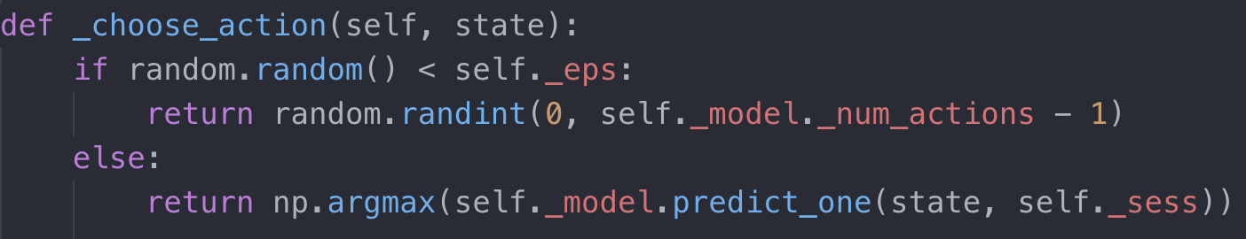
To make the model think
“outside the box”
Randomness
[0, 1]
Decreases as the number of episode increases
[0, 1]
A random action will be chosen
ELSE: Choose action based on the current model

Slide 20
REINFORCEMENT LEARNING
MODEL
AGENT
PENALTY
& STATE
ACTION
ENVIRONMENT
In Reinforcement Learning, the MODEL learns
through TRIAL AND ERROR using feedback form in every EPISODE

